Slide 1

E D U C T I O N A L P S Y C H O L O G Y S E R V I C E
Precision Teaching with ‘Letters and Sounds’
Session 2
Homer First School
Scott I-Patrick

Slide 2
Session Aim
Sharing our experiences since the last session
How do I deliver PT?
Target setting
Teaching and probing
Charting the results with target child
Monitoring: Review and adapt the programme as needed

Slide 3
How do I deliver precision monitoring?
Identify a specific difficulty and acquire a baseline.
Set a target.
Teaching sessions: short, frequent and target specific.
Monitor child’s daily performance using a probe.
Chart results and make note of teaching methods.
Analyse the data to determine if a change of target is needed or change in teaching method.
Notes:
There are 6 steps to delivering precision monitoring;
Identify a specific difficulty and acquire a baseline.
Setting a target.
Teaching
Monitor child’s performance daily. (We’ve used the word PROBE here – we’ll come back to this)
Charting results and making a note of teaching methods.
Analysing data to determine if a change of target or teaching method is needed.

Slide 4
STEP 1
Identify a specific difficulty and acquire a baseline
Notes:
The next stage is to look at the placement probes results from the baseline assessment that you have carried out.
Decide which area needs to be focused on next (sight words or phonic development)
Identify from your assessment data where the pupil is on the cusp of achieving the rate of 50 words per minute with no more than 2 errors. This is your starting point for the next step
Use the sublevel probes for the phase that you are working on as each one covers a smaller set of sounds/phonemes.
You can also construct your own probe sheets.

Slide 5
Step 2 - Setting a Target
SMART TARGETS
S
Specific
Measurable
Agreed
Realistic
Time bound
M
A
R
T
Notes:
SPECIFIC -Clear objectives, start with small steps but vary step-size according to data
MEASURABLE – set an appropriate aim rate and monitor progress daily by probing and charting results
ACHIEVABLE – get the task difficulty right
REALISTIC – Is the task appropriate? Check pre-requisite skills
TIME-RELATED – Evaluate carefully over an agreed period of time

Slide 6
2. Targets
Target needs to contain three essential components:
Observable verb
(ie. what the child will do)
Conditions
(e.g. teaching materials or teacher instructions)
Criterion
(success criteria – how will we know it’s been successful?)

Slide 7
2. Targets
E.g.
“Scott will read aloud (observable verb) 50 words per minute with no more than 2 errors (conditions) on three consecutive days (criterion).”
Notes:
So… In practice…. The target might sound like this….
“Scott will read aloud (observable verb) 50 words per minute with no more than 2 errors (conditions) on three consecutive days (criterion).”
So within this target we can see….
What we want the child to do (read 50 words per minute)
Teacher instructions (no more than 2 errors)
Success Criteria (3 consecutive days)
….. Any questions

Slide 8
Step 3- Teaching (Up to 10 mins per day)
Choose up to three words the child struggled with from your baseline assessment (NB: the number of words chosen to focus on may vary according to child’s difficulties).
Introduce the target words to child.
Use teaching strategies which will increase opportunities for child to recognise the words.
Notes:
Sessions should include around 10 minutes of specific teaching input
The teaching input is followed by a 1 minute timed test - known as a probe
Direct teaching’ is a useful approach to acquire skills such as
When ‘teaching’ do choose some words that the child already knows
Note the teaching method on the chart, keep the teaching method the same so you can equate progress to the child, not the method.
Number bonds
High frequency words
Phonemes

Slide 9
3. Teaching methods
E.g. Direct Instruction
Model (adult) – “this word says…”
Lead (together) – “say it with me”
Test (child) – “you say it”… or “what word?”
Use the model-lead-test sequence with each sight word in turn
Alter the sequence and continue until each word has been repeated 3-5 times
Explain to the pupil that they are going to try the sight words alone- but they may have help if they want it
The pupil tries the words alone – praise correct answers. If the word is incorrect or if the pupil hesitates more than 2 seconds use the correction procedure:
Model (adult) “this word says…”
Test (child) “now you say it”… or “what word?”
Notes:
One teaching method that has been used widely, and has been researched widely is direct teaching.
The basic structure is ‘the teacher’ model the word, you say it together, then the child tries on their own.
Doing it this way, allows the child to hear the word before they attempt it and reduces the possibility and anxiety of failing.

Slide 10
3. Examples of some teaching methods:
Magnetic Letters
Can you use the letters to make the words: is that had went
A S T
D H I Y
A E W
Notes:
Here is another teaching method that could be used, magnetic letters.

Slide 11
3. Examples of some teaching methods:
Jumbled Letters Activity
Can you find these words below?
is that had went
W D A T
I N E H T H
S T A
T
A H T T W
N E
Notes:
Another teaching method is can you find the word within the jumbled words

Slide 12
Points to remember
Make sure the pace is good- keep things flowing
Include pointing, to signal the pupil’s turn
Include intonation
Praise must be immediate, specific, positive
Avoid word-building- just give the sight word

Slide 13
Step 4 – Monitoring Performance
Using a Probe sheet
What is a probe sheet?
Notes:
So we’ve mentioned the word … Probe a few times… and you’ve been using probes. Are you happy that you understand the concept of the probe?
A tool for assessment…
We have provided a CD rom with a useful tool for designing probes….
GIVE EXAMPLE!! – refer to website…

Slide 14
Basic ‘Probe’ sheet
The Probe sheet is the stimulus for a short timed test (a ‘Probe’) usually for 1 minute in duration
A sheet with target
words in randomised
order is used for
reading – ‘see to say’
The child is timed and reads as many words as they can in 1 minute (go back to top of probe if child reads all the words in under a minute).
Name aim rate
Notes:
[Refer to probes sheets already with pairs]
Explain that these probes require the child to look at the word- See and say the word- therefore probes for word reading are referred to as See-to-say probes.
This is a blank probe but if you were testing words the probe would be filled randomly with the words you had decided to focus on.

Slide 15
Types of probe:
See to say e.g. letter, number, sight word recognition
Hear to write e.g. letter sounds, numbers, spellings
See to write e.g. 3 + 6 =
Notes:
Sharon
[1 minute]
Explain that in order to keep things simple for our condensed training, we’ll be focusing on ‘see to say’ probes – relate back to Learning Hierarchy – want to develop confidence in see-to-say before adapting technique to other types of probe
Talk about setting aim rates
See to say 50 cpm ( for Junior children) Note this is for reading: letter, number, sight word recognition If working with number bonds for example the aim rate would need to be adjusted (demands more than just reading) – easiest way is to try probe on a child whose achieved an acceptable level of competence in that area – this will give you an idea of appropriate aim rate
Explain that aim rates are set for accuracy as well as fluency – no more than 3 errors – i.e. 3 errors or less

Slide 16
Designing Probes
High Frequency
Progression through high frequency sightwords listed in ‘Letters and Sounds’
Phonic Development
The content of the probe is rule bound i.e. the probe should include as many examples as possible to test the rule

Slide 17
PT Probe Generator
http://johnandgwyn.co.uk/probe.html
Notes:
5 mins
Demonstrate how to make probes using the First 100 High Frequency Words
Explain how to use an assessment probe to determine which words are secure, and which need to be worked on

Slide 18
Step 5- Chart Results
Chart results with the child – helps to motivate the child & increase confidence.
Helps teacher to see which teaching methods are most effective for particular pupil (record on chart).
Record any changes made to task.
Record the number of correct AND incorrect words.
If you are unable to do the probe on a particular day, that line is left blank.
Notes:
Step 5. A useful way to monitor performance is to chart the results.
Charting the results enables;
Quick and easy recording.
The children can see how well they are progressing.
The teachers can see how effective their teaching has been.

Slide 19
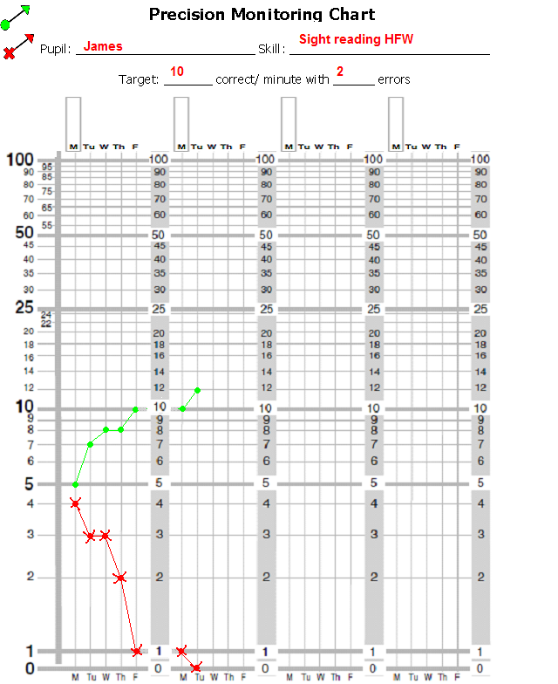

5. Recording
Pupil_______________
Criterion:
_____ correct with
max ____errors
Key:
Correct answers
Incorrect answers
Remember: Do not join across
weekends or across days when a
pupil was not tested.
Notes:
So in your pack there should be a blank chart.
So… as you can see the lines at the bottom are further apart than the lines in the middle.
This is because the proportion of progress is larger from 1 to 10 than from 10 to 20.
So… there is a greater percentage of progress from learning 1 to 2 words than from learning 8 to 10 words.
Explain the chart – You would fill in the date along the bottom.
- A dot = Correct
- A cross = Errors
The scale runs along the left hand side. ( So in your case number of signs, but it could be numbers of words, number bonds…etc)
As its stands its not child friendly – be creative – feel free to add stickers, cut it up and mount it on the wall in the classroom. I’m sure you’ll have plenty of ideas.
The child being able to see their results clearly and see what progress they have made should be used as a way of motivating the child. The child should be given praise and encouraged to increase their number of successes the following session.
Aim is for a crocodile mouth or increases in correct responses and decreases in errors
Remember qualitative info here is useful to see where the difficulties lie.

Slide 20
5. Ratio charts
The days the information is collected
This is shown on the horizontal axis.
There is a line for each school day.
The result is filled in on the line (NOT the space).
If you are unable to do the probe on a particular day, that line is left blank.
That day is known as a No Chance Day.
A description of the pupil’s performance
This is shown on the vertical axis.
It tells you the accuracy at which the pupil does the task.
This is expressed as a rate measurement i.e. the number of responses per minute.
Notes:
Run through the chart, pointing and using examples.

Slide 21
Setting Aim Rates
Suggested minimum Fluency Markers:
Infant Pupils = 40 correct per minute
Junior Pupils = 50 cpm
Secondary = 60 cpm
Suggested minimum
Accuracy Markers:
See-to-say = 3 or less
MAINTENANCE- ACHIEVE THE TARGET FOR 3
CONSECUTIVE DAYS
See-to-say
Notes:
2 mins

Slide 22
Step 6- Analyse the Data
Once the child has hit their target for 3 consecutive days move on to a new set of words.
The 3 day rule
Check after 3 days:
If the task appears too hard consider reducing the demands of the task (e.g. number of words to be learnt, types of words being learnt).
The 8 day rule
Check after 8 days:
If the pupil is not at or near their target after 8 days consider a change (e.g. increasing motivation, modifying teaching method, changing task).
Notes:
These are some fairly important rules.
If the target has been reached for 3 consecutive days, then change the words and set a new target.
After 3 days of a new target, check that the child is making some progress, if there has been no progress at all, consider reducing the task.
The child should be near to or have already achieved their target by the 8th day, this ensures the child does not get stuck on the same words forever and so that they themselves can see progress made quite quickly. If the child is nowhere near their target on the 8th day, consider a change.

Slide 23
6a. Change - response to data analysis
Chart Description
Chart Picture
Interpretation
Intervention
More errors than correct: No sign of a switch
x
Task inappropriate
3 day rule applies
Return or slice the task
Switch within first 3 days
x
Task probably inappropriate. Monitor progress, may be a blip
May need to return or slice the task
Both correct and incorrect rates increasing
x
Pupil is merely getting faster attempting more on the probe
Slow pupil down; encourage accuracy before speed
Some progress; accurate but shallow correct rate slope
x
Task is likely to be appropriate but progress not fast enough
Increasing motivation through rewards/ incentives or alter teaching methods
Notes:
If no progress is seen or not seen quickly enough then reset the target e.g. learn 2 words instead of 3. (interleaved words)
Here are a few examples of what the chart could look like.
We have some examples for you to try and decipher in a minute too
Errors are recorded by a ‘x’
Correct responses recorded by a ‘o’
Return – to a previously known skill – a pre-requisite.
Slice – Reduce the demands of the task, number of items to be learned/ simplify the task e.g. not all the CVC words, just CVC with the same medial vowel.
SHOW GOOD EXAMPLE CHART and TALK ABOUT IT.

Slide 24
6b. Maintenance
Once a pupil has reached fluency (hit target 3 days consecutively), change target
Check for maintenance at regular intervals by using an old probe to check they are still fluent with these words or interleave previously learnt words with new words
Notes:
After a child has succeeded and achieved their target, keep the probe word sheet, maybe a month later bring out the probe sheet randomly and ask the child to read the words, without prior teaching, make a note on a separate record chart/ sheet.
This way you can see if the child has retained the words that you taught them.
Generalisation:
benefits of PM- teaching method is the schools choice
Need good communication between teacher and TA to support generalisation e.g. using words/ skills in a different subject or classroom environment

Slide 25
Recap of the steps of precision monitoring
Identify a specific difficulty and acquire a baseline
Set a target
Teaching sessions (DI): short, frequent and target specific
Monitor pupil’s daily performance using a probe
Chart results (PM) and make note of teaching methods
Analyse the data to determine if a change of target is needed or change in teaching method
Notes:
So to recap:
Identify a specific difficulty and acquire a baseline – needs to be quantifiable. This is where you are working from and where you compare back to.
Setting a target.
Teaching – appropriate to individual needs and learning styles/ preferences.
Monitor child’s performance daily.
Charting results and making a note of teaching methods (qualitative data) (noting teaching method may let you see what has worked and what hasn’t)
Analysing data to determine if a change of target or teaching method is needed.

Slide 26


E D U C A T I O N A L P S Y C H O L O G Y S E R V I C E
Thank you
Please do not use or copy any slides without prior permission from RBWM EPS

